Slide 1




4.1 The night sky
March
Learning Outcomes
Key Words
Describe the objects that you can see in the night sky
Describe the structure of the Universe
Artificial satellites
Orbit
Earth
Natural satellite
Moon
Planets
Sun
Solar system
Comet
Meteors
Meteorite
Stars
Galaxy
Universe

Slide 2

Starter Activity!
How many stars do you think you can see at night?
Estimations of the number of stars seen at night range from 2 500 to 5 000. These are just the stars that are visible, within our galaxy.

Slide 3
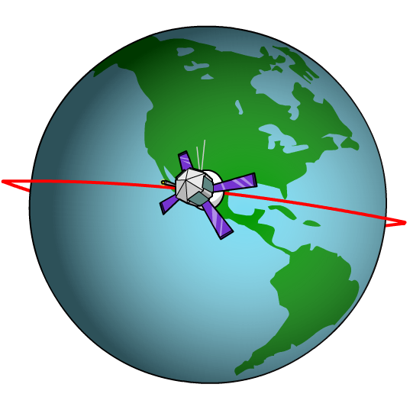
Satellites
A satellite is any object that orbits another object.
The Moon is a natural satellite of the Earth and is kept in orbit by the attraction of the Earth’s gravity and by its motion.
An artificial satellite is an object made by,
and put into orbit by, humans.
You can see the international space station with the
naked eye. Light reflected from the ISS reaches us in
a fraction of a second.

Slide 4
Planets in our Solar System
5 planets that most people can see with the naked eye are: Mercury, Venus, Mars, Jupiter and Saturn.
Venus gets closest to the Earth about two light minutes away. Light from Saturn takes 1.5 hours.
Is Pluto a planet?

Slide 5
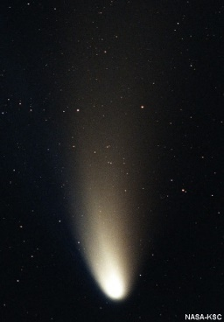
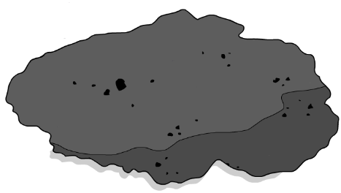
Comets and meteors
YouTube video
Comets also travel around the Sun. For most of its orbit, a comet is a long
way from the Sun. The head of a comet head is a lump of ice and dust. The tail only appears when the
comet’s orbit takes it nearest to the Sun.
As the Earth moves through space, it collides with lumps
of material which burn up in the atmosphere. These are called meteors and can be seen as streaks of light in the night sky. A large meteor may not burn up completely and hits the Earth with a lot of energy. This is called a meteorite.

Slide 6
Objects in space – match up

Slide 7
Our galaxy and the Universe
Light takes about 8 minutes to get to us from the Sun, our nearest star.
Our next nearest star is over 4 light-years away. Our nearest large galaxy is Andromeda which you can see with the naked eye.
Light from Andromeda takes 2 million years to get to Earth.

Slide 8
Size in the Universe

Slide 9
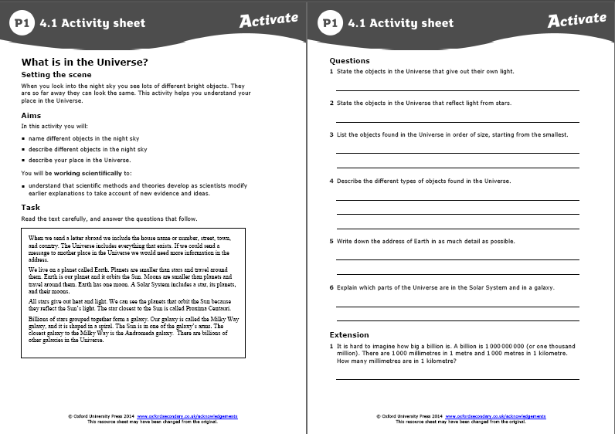
TASK

Slide 10

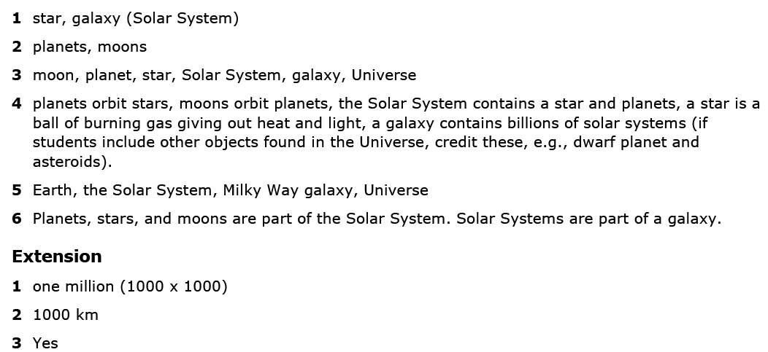
Answers

Slide 11
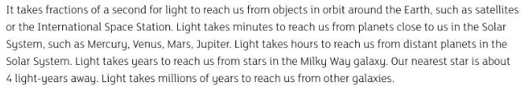

6 mark question
Compare the time it takes light to reach us from the different objects that you can see in the night sky.

Slide 12
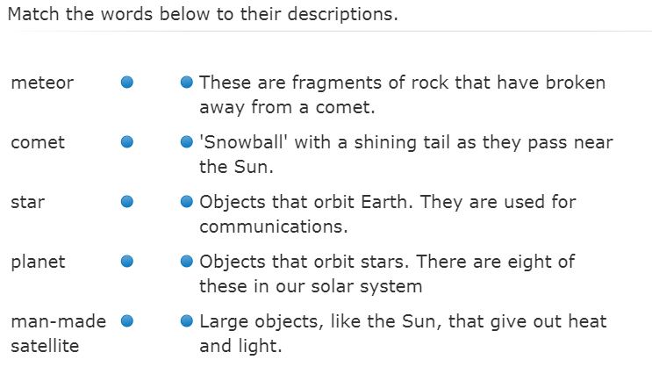
Plenary

Slide 13
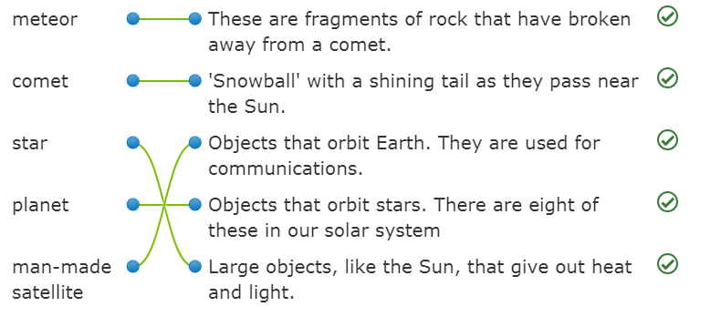
Answers

Slide 14
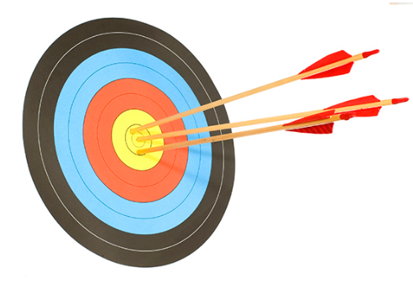
Key Points this lesson
This lesson I have learnt:
the Solar System contains eight planets and a number of moons
the planets orbit the Sun, our star
the moons orbit planets
the Solar System is part of a galaxy called the Milky Way
the Milky Way is one of billions of galaxies that make up the Universe
the Universe contains everything.

Slide 15
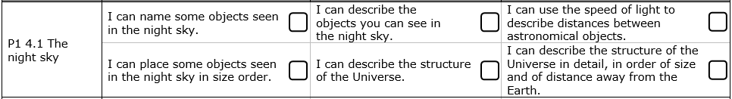
What have you learnt today?
Tick off the objectives you understand.

